Slide 1


Slide 2


ACADEMIC
Success
Academic
Success
Prediction
Name : Tanishka Milind Patankar.
Batch : FST 2.0 ML 09

Slide 3


Index :
Introduction
Type of model
Libraries
Algorithm
Steps in algorithm
Sigmoid function
Confusion Matrix
Data Visulation
Advantages and Disadvantages of logistic regression
Application of our model
Conclusion
Reference

Slide 4


INTRODUCTION :
The dataset includes information known at the time of student enrollment (academic path, demographics, and social-economic factors) and the students' academic performance at the end of the first and second semesters. The data is used to build classification models to predict students' dropout and academic success.

Slide 5


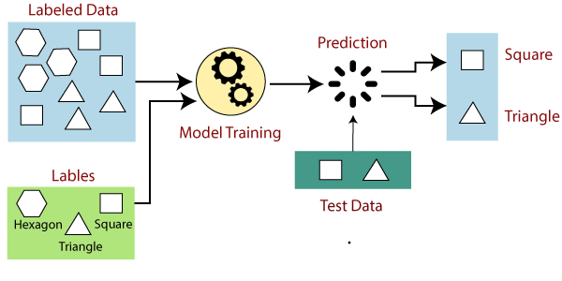
Type of Model :
Supervised
Supervised learning, also known as supervised machine learning,
is a subcategory of machine learning and artificial intelligence.
It is defined by its use of labeled datasets to train algorithms that
to classify data or predict outcomes accurately.

Slide 6

Libraries :
Python
Seaborn
Numpy
Sklearn
Python can be used for a large variety of development tasks.
It is capable of doing a number of machine learning tasks, which is why most algorithms are written in Python.
Seaborn is use to make a more attractive visualization of the central part of understanding and exploring data.
Numpy is a library for the Python programming language, along with a large collection of high-level mathematical functions to operate on these arrays.
It provides a selection of efficient tools for machine learning and statistical modeling including classification, regression, clustering and dimensionality reduction via a consistence interface in Python.

Slide 7

Algorithm :
Logistic regression :
Logistic regression is one of the most popular Machine Learning algorithms, which comes under the Supervised Learning technique. It is used for predicting the categorical dependent variable using a given set of independent variables. Therefore the outcome must be a categorical or discrete value. It can be either Yes or No, 0 or 1, True or False, etc.
Logistic Regression is much similar to the Linear Regression except that how they are used. Linear Regression is used for solving Regression problems, whereas Logistic regression is used for solving the classification problems.

Slide 8
Steps in Logistic Regression
To implement the Logistic Regression using Python, we will use the same steps as we have
done in previous topics of Regression. Below are the steps:
Data Pre-processing step
Fitting Logistic Regression to the Training set
Predicting the test result
Test accuracy of the result(Creation of Confusion matrix)
Visualizing the test set result.

Slide 9

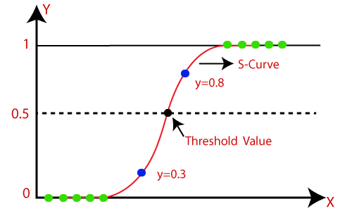
Logistic Function (Sigmoid Function):
The sigmoid function is a mathematical function used to map the
predicted values to probabilities.
It maps any real value into another value within a range of 0 and 1.
The value of the logistic regression must be between 0 and 1, which
cannot go beyond this limit, so it forms a curve like the "S" form. The
S-form curve is called the Sigmoid function or the logistic function.
In logistic regression, we use the concept of the threshold value, which
defines the probability of either 0 or 1. Such as values above the
threshold value tends to 1, and a value below the threshold values tends to 0.
Note: Logistic regression uses the concept of predictive modeling as regression; therefore, it is called logistic regression, but is used to classify samples; Therefore, it falls under the classification algorithm.

Slide 10

Confusion Matrix
A confusion matrix is a matrix that summarizes the performance of a machine learning model on a set of test data. It is often used to measure the performance of classification models, which aim to predict a categorical label for each input instance.
Accuracy
F1-score
Precision
Recall
Accuracy is used to measure the performance of the model.
F1-score is used to evaluate the overall performance of a classification model. It is the harmonic mean of precision and recall
Precision is a measure of how accurate a model’s positive predictions are.
Recall measures the effectiveness of a classification model in identifying all relevant instances from a dataset.

Slide 11

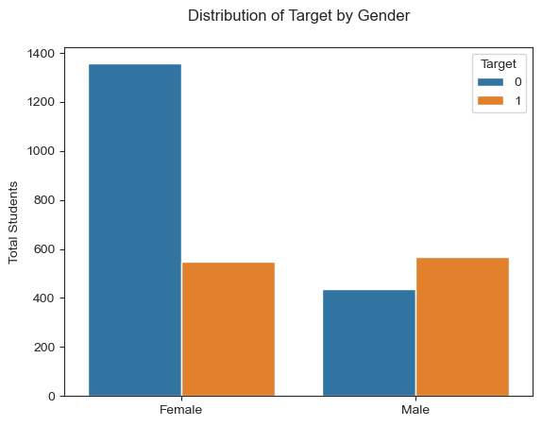
Data Visulation :
According to the data there are many more female graduates than male graduates. There appears to be a much larger sample of female students than male students. From this visualization it is easy to see that males are much more likely to drop out than females.

Slide 12
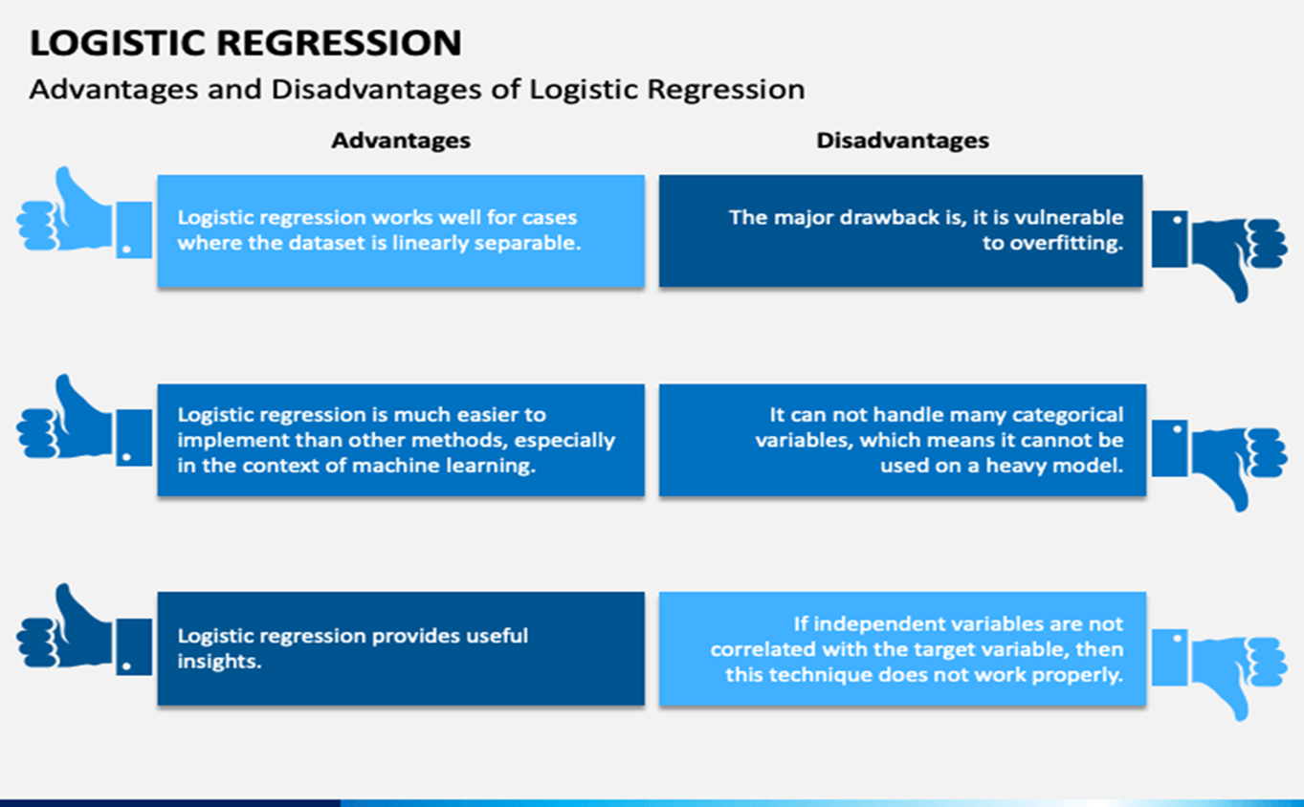

Slide 13
Real Life Application
Admission and Scholarships
Retention and Graduation Rates
Course Placement and Curriculum Design
Early Warning Systems

Slide 14

Conclusion :
Based on the results of this analysis, the logistic regression model produces the best overall fit metrics and is the optimal supervised machine learning model to accurately predict student dropouts in this sample population. The logistic regression model accurately predicts 92% of student dropouts and can be used to target communications and allocate resources to help prevent students at risk from dropping out.

Slide 15

Refrence
Predict students dropout, academic success👨‍🎓📖
'/kaggle/input/predict-students-dropout-and-academic-success/dataset.csv’
From the kaggle website we can use this real life data set

Slide 16


